Slide 1
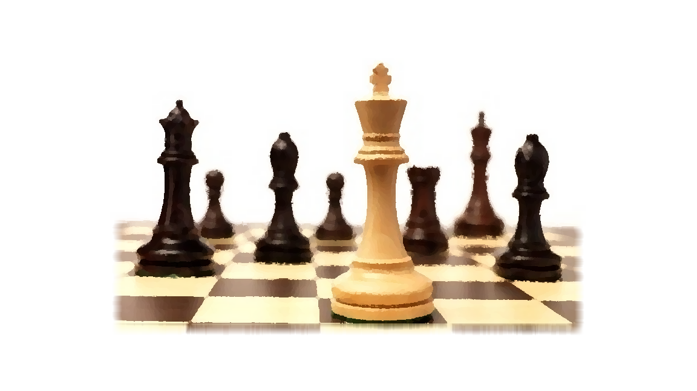
“He may have the preeminence”
Colossians 1:13-18
Notes:
Context:
Paul expresses to the Colossians that he continually prays for them, that they would walk worthily, and in doing so they would fully please God.
It is God who has “qualified us to be partakers of the inheritance of the saints in the light.” (12).
Our text establishes that the means of accomplishing our redemption is through God’s establishment and exaltation of His only begotten Son.
(Colossians 1:13-18) READ
What does the term preeminence mean? The definition is simple - to be first, hold the first place (Thayer) (prōteuō)
It indicates that Jesus Christ is first in rank, in dignity, in honor, in power.
As Paul shows, this preeminence is in both the material realm and in the spiritual realm
Consider Paul’s words in this text

Slide 2

The preeminence of Jesus Christ
The Kingdom/Church God conveys us into belongs to Him (13,18)
Notes:
The Kingdom/Church God conveys us into belongs to Jesus Christ (13,18)
Consider how great this power is. While on earth, Jesus had the power to heal a paralyzed man (Luke 5). But first, he said to him, “Man, your sins are forgiven you” (Luke 5:20).
The two acts (delivered from darkness/translated into the kingdom) are distinct, but inseparable!
When men are baptized in his name, their sins are forgiven AND they are added to the church…
(Acts 2:47), “And the Lord added to the church daily those who were being saved.”
That Church belongs to Him (the called out)
(Matthew 16:18), “And I also say to you that you are Peter, and on this rock I will build My church, and the gates of Hades shall not prevail against it.”
The Kingdom is His! (the citizens)
(1 Timothy 6:13-16), [Paul’s exhortation to his friend in this letter}, “I urge you in the sight of God who gives life to all things, and before Christ Jesus who witnessed the good confession before Pontius Pilate, ¹⁴ that you keep this commandment without spot, blameless until our Lord Jesus Christ's appearing, ¹⁵ which He will manifest in His own time, He who is the blessed and only Potentate, the King of kings and Lord of lords, ¹⁶ who alone has immortality, dwelling in unapproachable light, whom no man has seen or can see, to whom be honor and everlasting power. Amen.”

Slide 3
The preeminence of Jesus Christ
The Kingdom/Church God conveys us into belongs to Him (13,18)
He is the unique Messiah (14)
Notes:
The singular Messiah who brings forgiveness is Jesus Christ (14)
(14), “In whom we have redemption through His blood, the forgiveness of sins.”
He ONLY was qualified to save us!
(Revelation 5:8-10), “Now when He had taken the scroll, the four living creatures and the twenty-four elders fell down before the Lamb, each having a harp, and golden bowls full of incense, which are the prayers of the saints. ⁹ And they sang a new song, saying: “You are worthy to take the scroll, and to open its seals; for You were slain, and have redeemed us to God by Your blood out of every tribe and tongue and people and nation, ¹⁰ and have made us kings and priests to our God; and we shall reign on the earth.”
(Hebrews 10:4,10), (4), “For it is not possible that the blood of bulls and goats could take away sins.” … (10), “By that [God’s] will we have been sanctified through the offering of the body of Jesus Christ once for all.”
He is not MORE unique, or the MOST unique. He is unique! (One of a kind)
(Acts 4:11-12), [Peter’s words to the Jewish religious leaders in Jerusalem], “This is the ‘stone which was rejected by you builders, which has become the chief cornerstone.’ ¹² Nor is there salvation in any other, for there is no other name under heaven given among men by which we must be saved.”

Slide 4
The preeminence of Jesus Christ
The Kingdom/Church God conveys us into belongs to Him (13,18)
He is the unique Messiah (14)
He is the cause and ruler of all creation (15-17)
Notes:
He is the cause and ruler of all creation (15-17)
He is Divine! (15) “the image of the invisible God.” (Word signifies a manifestation)
(John 14:9), [Jesus told Philip], “He who has seen Me has seen the Father.”
(Matthew 1:23), “Behold, the virgin shall be with child, and bear a Son, and they shall call His name Immanuel,” which is translated, “God with us.”
(John 1:1, 14), (1), “In the beginning was the Word, and the Word was with God, and the Word was God.” … (14), “And the Word became flesh and dwelt among us, and we beheld His glory, the glory as of the only begotten of the Father, full of grace and truth.”
The originator of all creation is Jesus Christ (15-16)
Firstborn (prototokos) – can signify either birth or privilege as in our context. It describes Jesus’ relationship to creation. “The point is not that Christ is a part of creation, but that He is both before it, and above it!” (Walton Weaver, Truth Commentary)
He created all things!
(John 1:2-3), “He was in the beginning with God. ³ All things were made through Him, and without Him nothing was made that was made.”
All of creation is subservient to Jesus Christ (16b - 17)
All things were created through Him and FOR HIM
He is before all things
God’s intended purpose for all of creation is finally realized in Christ and His redemptive work! (i.e. – Our universe is THEOCENTRIC, cf. Revelation 4 & 5)
(Ephesians 1:10), “that in the dispensation of the fullness of the times He might gather together in one all things in Christ, both which are in heaven and which are on earth—in Him.”

Slide 5
The preeminence of Jesus Christ
The Kingdom/Church God conveys us into belongs to Him (13,18)
He is the unique Messiah (14)
He is the cause and ruler of all creation (15-17)
He is the head of the church (18)
Notes:
The head of the church is Jesus Christ (18)
The emphasis here shifts from the material to the more important spiritual realm
Not only is Christ preeminent in our material world, He is the head of the church!
This indicates His authority. The head rules the body!
(Colossians 3:17), “And whatever you do in word or deed, do all in the name of the Lord Jesus, giving thanks to God the Father through Him.”
This indicates the spiritual life and sustenance we receive is from Him
(Ephesians 4:15-16), [Paul indicates that the body], “may grow up in all things into Him who is the head—Christ— ¹⁶ from whom the whole body, joined and knit together by what every joint supplies, according to the effective working by which every part does its share, causes growth of the body for the edifying of itself in love.”
Everything we do as the body of Christ should center in Him, and His purpose for us on earth. Anything else is unthinkable, which is why changing the church into benevolent society, a political tool or a social institution is so horrific and wrong.
It is all about Him, and the Redemption that He payed such a steep price to give us!

Slide 6
Conclusion
God established His Son as the preeminent One!
Notes:
Conclusion: God established His Son in such a way “that in all things He may have the preeminence”
The only way anything makes sense in our lives is if Jesus is at the center.
We do not live in an uncaring, and senseless universe
But, there is only one reason why we are here, and only one way to have a meaningful life.
Meaning comes in service to God, and acceptance of Jesus as the Preeminent One!

